Slide 1
Linux device driver
Day 43 PPT
-SUBITHRA s

Slide 2
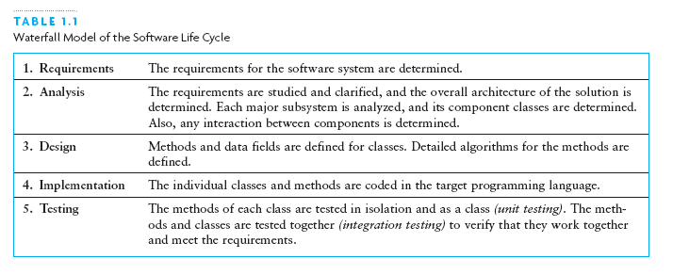
Waterfall Model

Slide 3
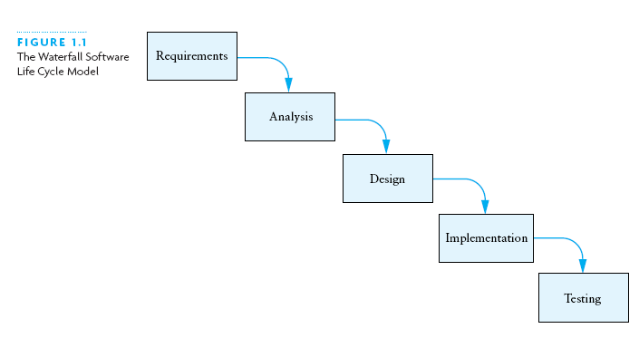
Waterfall Model (2)

Slide 4
Other Software Life Cycle Models
Common theme among models: stages or cycles
Unified Model:
Cycles are called phases and iterations
Activities are called workflows
The four phases of the Unified Model:
Inception
Elaboration
Construction
Transition

Slide 5
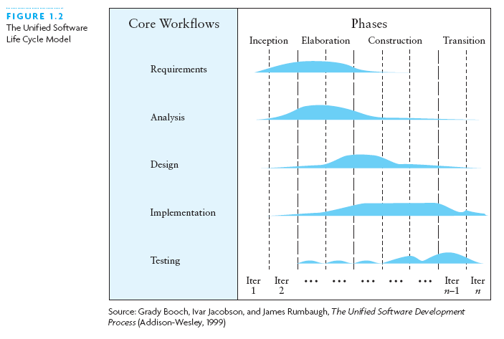
Other Software Life Cycle Models (2)

Slide 6
Software Life Cycle Activities
Activities essential for successful development:
Requirements specification
Architectural, component, & detailed designs
Implementation
Unit, integration, and acceptance testing
Installation and maintenance

Slide 7
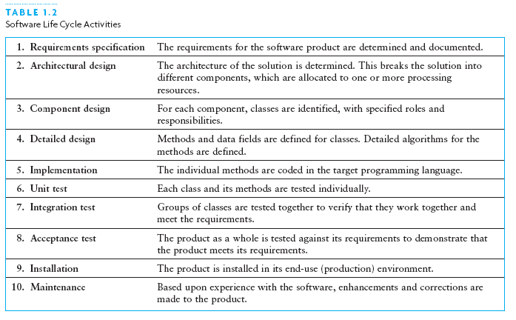
Software Life Cycle Activities Defined

Slide 8
Software Life Cycle Activities (more)
Requirements Specification
System analyst works with users to clarify the detailed system requirements
Questions include format of input data, desired form of any output screens, and data validation
Analysis
Make sure you completely understand the problem before starting the design or program a solution
Evaluate different approaches to the design

Slide 9
Software Life Cycle Activities (continued)
Design
Top-down: break system into smaller subsystems
Object-oriented: identify objects and their interactions
UML diagrams: tool to show interactions between:
Classes (inside the system)
Classes and external entities

Slide 10
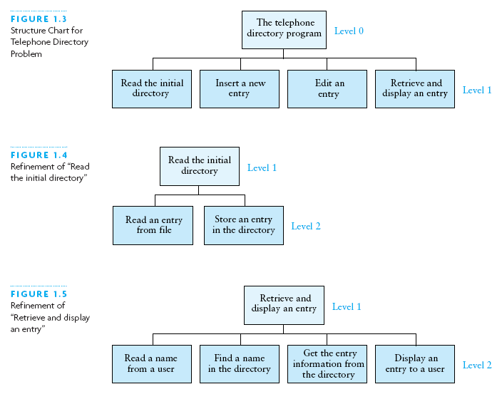
Example of Top-Down: Stepwise Refinement

Slide 11
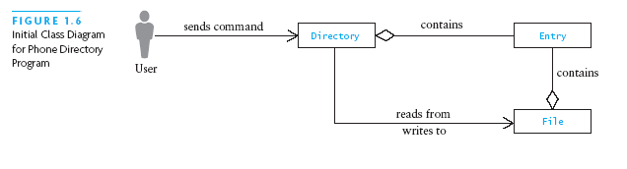
Example of Object-Oriented: Class Diagram

Slide 12
Using Abstraction to Manage Complexity
An abstraction is a model of a physical entity or activity
Models include relevant facts and details
Models exclude matters irrelevant to system/task
Abstraction helps programmers:
Complex issues handled in manageable pieces
Procedural abstraction: distinguishes ...
What to achieve (by a procedure) ...
From how to achieve it (implementation)
Data abstraction: distinguishes ...
Data objects for a problem and their operations ...
From their representation in memory

Slide 13
Using Abstraction to Manage Complexity (2)
If another class uses an object only through its methods, the other class will not be affected if the data representation changes
Information hiding: Concealing the details of a class implementation from users of the class
Enforces the discipline of data abstraction

Slide 14
Abstract Data Types, Interfaces, and Pre- and Post-conditions
A major goal of software engineering: write reusable code
Abstract data type (ADT): data + methods
A Java interface is a way to specify an ADT
Names, parameters, return types of methods
No indication of how achieved (procedural abstraction)
No representation (data abstraction)
A class may implement an interface
Must provide bodies for all methods of the interface

Slide 15
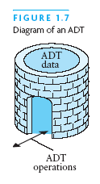
Abstract Data Types, Interfaces, and Pre- and Postconditions (2)

Slide 16
Abstract Data Types, Interfaces, and Pre- and Postconditions (continued)
You cannot instantiate (new) an interface
But you can:
Declare a variable that has an interface type
Use it to reference an actual object, whose class implements the interface
A Java interface is a contract between
The interface designer and ...
The coder of a class that implements the interface
Precondition: any assumption/constraint on the method data before the method begins execution
Postcondition: describes result of executing the method

Slide 17
Requirements Analysis: Use Cases, and Sequence Diagrams
Analysis first step: study input and output requirements:
Make sure they are understood and make sense
Use case:
User actions and system responses for a sub-problem
In the order that they are likely to occur
Sequence diagram:
Shows objects involved across the horizontal axis
Shows time along the vertical axis
See page 26 for an example; shows:
User, PDApplication, PhoneDirectory, BufferedReader, PDUserInterface object + a number of method calls

Slide 18
Design of an Array-Based Phone Directory
Case study shows:
Design
Implementation
Testing of a software-based phone directory
In UML class diagrams:
+ sign next to a method/attribute means it is public
- sign next to a method/attribute means it is private

Slide 19
Design of Array-Based Phone Directory
Classes/interfaces to design include:
PDUserInterface: interface; later we consider:
Console (command line) UI class
Graphical (JOptionPane) UI class
PDApplication: main / driving class
PhoneDirectory: interface
ArrayBasedPD: class implementing PhoneDirectory
DirectoryEntry: class, for one item in the directory

Slide 20
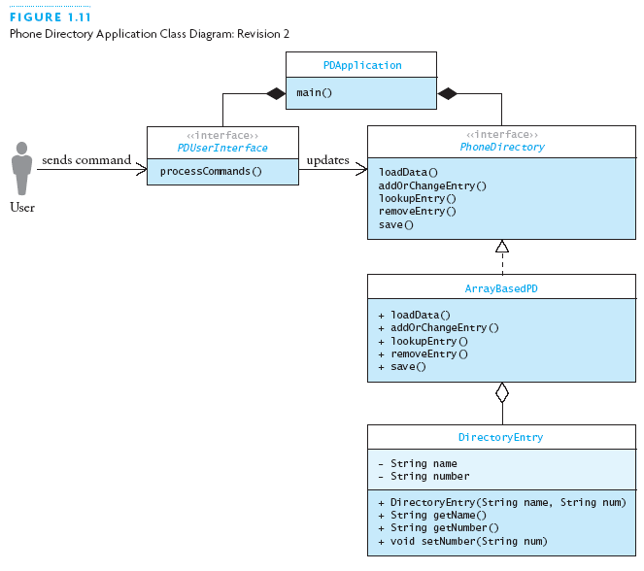
Design of Array-Based Phone Directory (2)

Slide 21
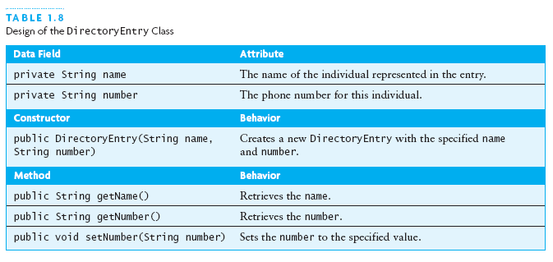
Design of Array-Based Phone Directory (3)

Slide 22
Design of DirectoryEntry
Simple class, similar to Person in Java review:
Two private fields, for name and number
Two-argument constructor
Get methods for both fields
Set method for number (only)

Slide 23
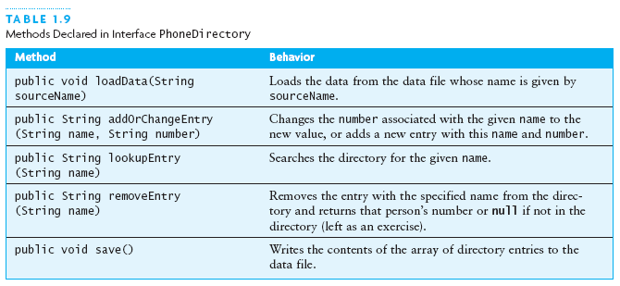
Design of Array-Based Phone Directory (4)

Slide 24
The PhoneDirectory Interface
/**
* The interface for the telephone directory.
* @author Koffman & Wolfgang
*/
public interface PhoneDirectory {
...
}
Shows syntax of an interface
Shows a javadoc comment and the @author tag

Slide 25
PhoneDirectory.loadData
/** Load the data file containing the
* directory, or establish a connection with
* the data source.
* @param sourceName The name of the file
* (data source) with the phone directory
* entries
*/
void loadData (String sourceName);
Shows syntax of method in an interface (note ;)
Shows a javadoc comment with the @param tag
Since returns void, no @return tag

Slide 26
PhoneDirectory.lookupEntry
/** Look up an entry.
* @param name The name of the person
* to look up
* @return The number, or null if name
* is not in the directory
*/
String lookupEntry (String name);
Shows a javadoc comment with the @return tag
I prefer a space before the ( in a declaration (not a call)

Slide 27
PhoneDirectory.addOrChangeEntry
/** Add an entry or change an existing entry.
* @param name The name of the person being
* added or changed
* @param number The new number to be assigned
* @return The old number or, if a new entry,
* null
*/
String addOrChangeEntry (String name,
String number);
Shows a javadoc comment with two @param tags

Slide 28
PhoneDirectory.removeEntry
/** Remove an entry from the directory.
* @param name The name of the person to be
* removed
* @return The current number. If not in
* directory, return null
*/
String removeEntry (String name);

Slide 29
PhoneDirectory.save
/** Method to save the directory.
* pre: The directory is loaded with data.
* post: Contents of directory written back to
* the file in the form of name-number pairs
* on adjacent lines;
* modified is reset to false.
*/
void save ();
Illustrates pre/post conditions

Slide 30
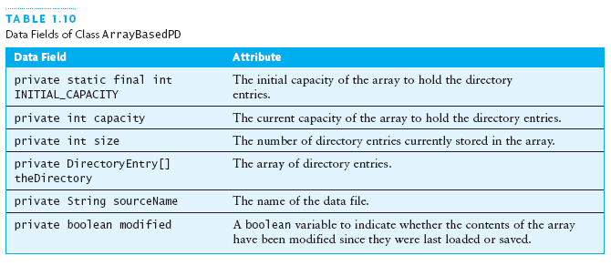
Design of Array-Based Phone Directory (5)

Slide 31
Design of ArrayBasedPD.loadData
Input: a file name; Effect: read initial directory from the file
Create a BufferedReader for the input
Read the first name
while the name is not null
Read the number
Add a new entry using method add
Read the next name

Slide 32
Design of ArrayBasedPD.addOrChangeEntry
Input: name and number; Effect: change number of existing entry, or make new entry if there was none
Call method find to see if the name is in the directory
if the name is in the directory
change number with DirectoryEntry.setNumber
Return the previous value of the number
else
Add a new entry using method add
Return null

Slide 33
Design of Array-Based Phone Directory (6)
Remaining method designs proceed along the same lines
The class diagram changes, showing private fields and methods added ....

Slide 34
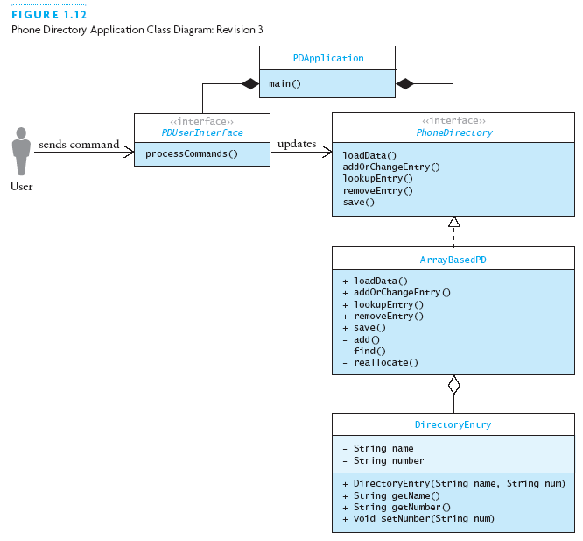
Design of Array-Based Phone Directory (7)

Slide 35
THANK YOU

